Slide 1

Data Structure Visualization
Data Structure implementation using java

Slide 2
Project Team
Eman Mamdouh
Fatma Mohamed
Rowan Omar
Supervised by:
Prof. Dr. Mahmoud Ali

Slide 3
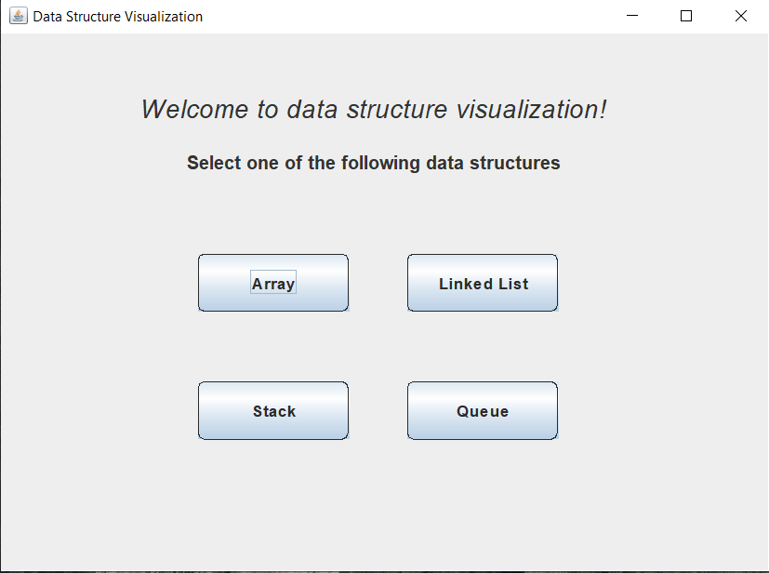
Project entry window
When the user runs the program, a start window of the program appears.
Here, the user is capable of selecting different data structures and some with different implementations to see their performance to help selecting “best” data structure.
The user can enter either strings or integers in his/her selected data structure and they are informed when something goes wrong.
We need to mention that if the user wants to perform the removal operation, they must do the removal before adding any new item.
The time consumed is measured after each operation for the selected data structure, to help compare how much would it take to perform an operation in each data structure.

Slide 4
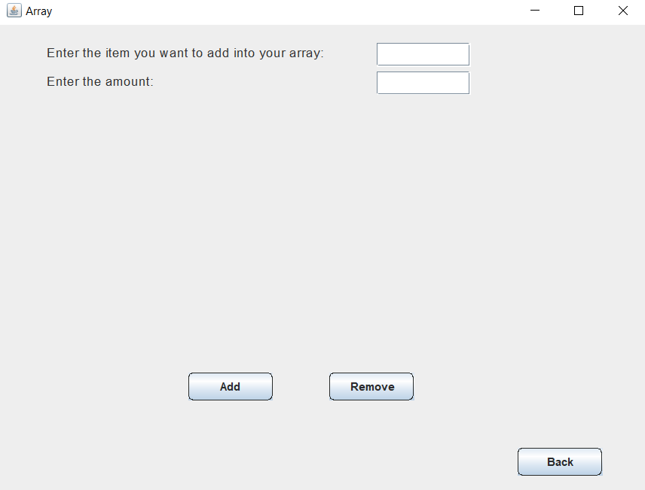
Array Data Structure
If the user selects the array data structure, a window will appear where the user could do some operations on that data structure.
If the user is to choose to add an item, he/she needs to enter that item in the first text field, and how many times this item will be repeated in the array in the second text filed.

Slide 5
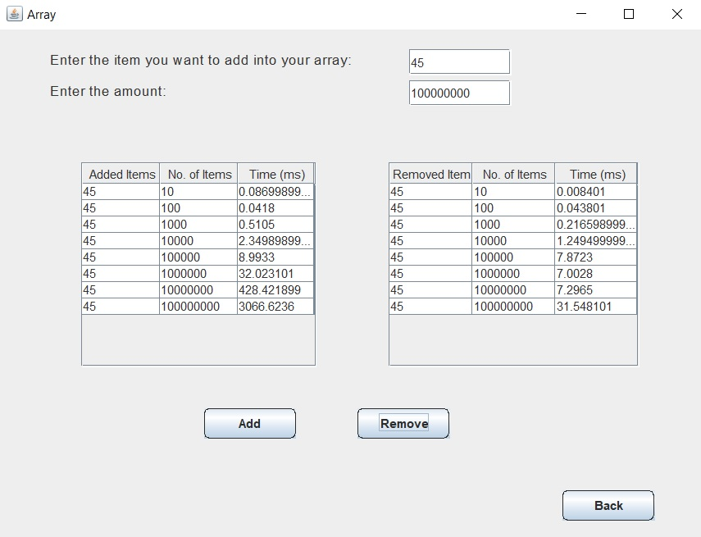
Array Data Structure (Cont’d)
If, for example, the user enters the number 45 and to be added these many times as shown in the figure, he/she will be able to see that item with the entered amount are added, and the time taken to perform each insertion operation.
We need to mention that the insertion operations happen in the last place available in the array. And the removal operations happen in the last, actually filled position in the array.
This gives time complexity that is O(1) since we are not required to sort the elements.

Slide 6
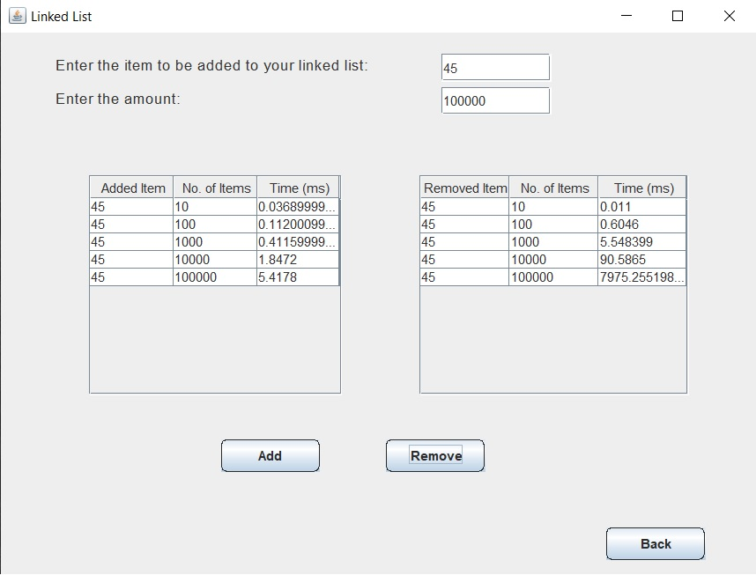
Linked List Data Structure
If the user has chosen the linked list data structure for his explorations, he would also nearly the same window as in the array structure.
Here, the insertion operation in each time is done in the last available place in the linked list and thus taking O(1) as time complexity since we are using a reference to the end node of the list.
For the removal operation, although we are using a reference to the node just before the last node but the time complexity is O(n).

Slide 7
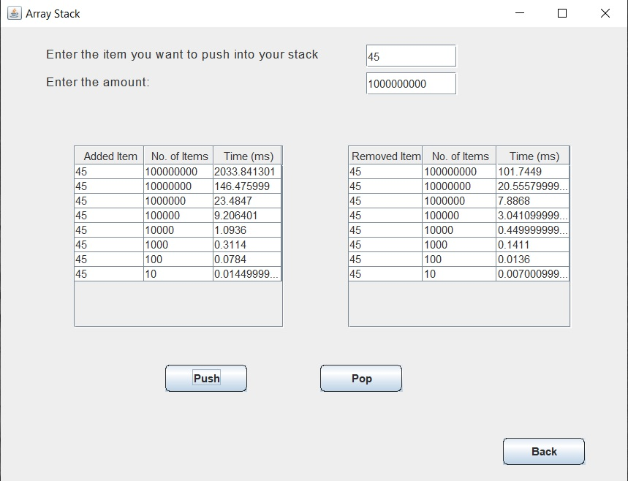
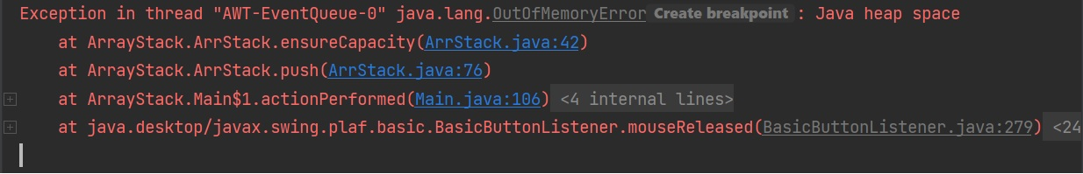
Stack Data Structure (Array Implementation)
Now, the user has chosen the stack data structure specifically the array implementation of the stack.
The stack as you know it is called LIFO data structure, which means the last pushed item is the first to be removed. So adding and removing is at the same end.
For the insertion operation, we would get time complexity as O(1). In addition, for the removal operation, we would have time complexity as O(n).
However, we would find that we get “OutOfMemoryError” when trying to add the number “45” 10^9 many times. This is because the array structure adds the elements in contiguous places in the memory and all the available places in memory are filled.

Slide 8
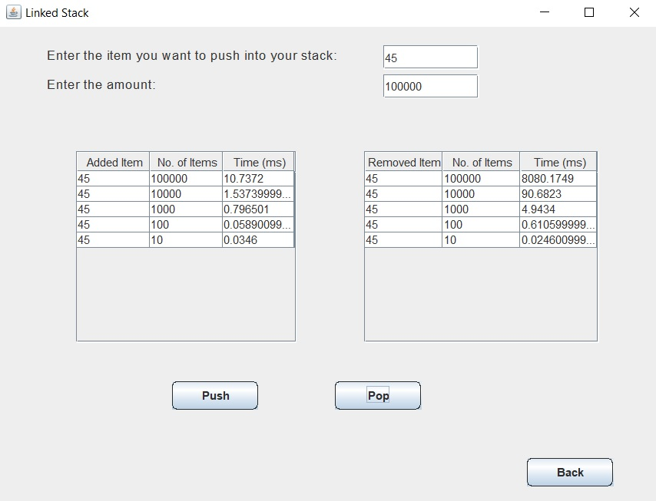
Stack (Linked List Implementation)
For the linked list implementation of the stack, for the insertion operation, we would get time complexity as O(1).
In addition, for the removal operation, we would have time complexity as O(1).
//Here the programs stops for the 10^5 times

Slide 9
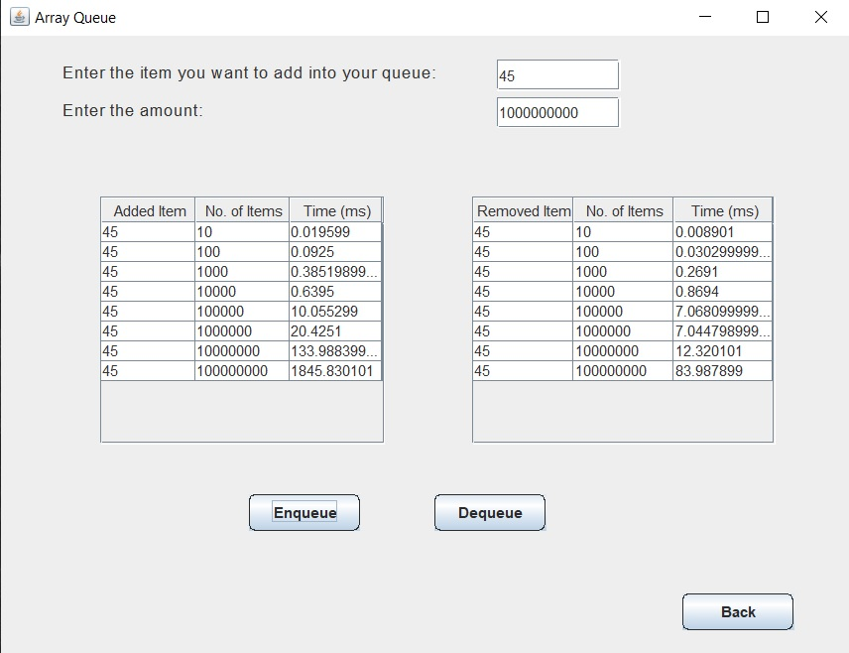
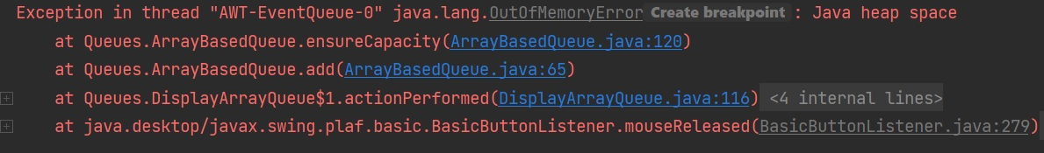
Queue Data Structure (Array Implementation)
Here is the queue data structure by the array implementation.
The queue is called FIFO data structure, which means the first added item is the first to be removed. Here adding and removing are at opposite sides.
For the insertion operation, we would get time complexity as O(1).
In addition, for the removal operation, we would have time complexity as O(1).
However, we would find that we get “OutOfMemoryError” when trying to add the number “45” 10^8 many times. The same as with the stack implementation using arrays.

Slide 10
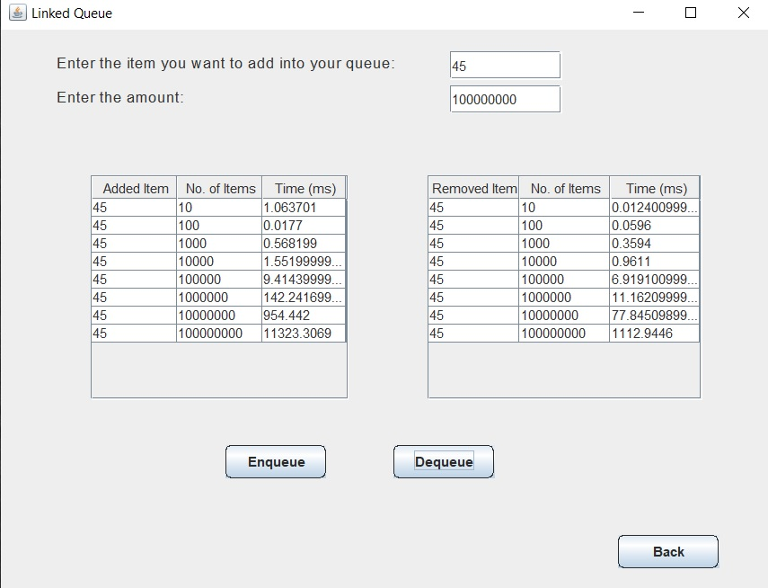
Queue (Linked List Implementation)
For the linked list implementation of the queue, for the insertion operation, we would get time complexity as O(1).
In addition, for the removal operation, we would have time complexity as O(1).

Slide 11
Array VS Linked List Insertion Operation
Conclusion: for the same number of inputs, the linked list is slower. This is because the huge memory locations needed for the linked list

Slide 12
Array Stack VS Linked List Stack Insertion Operation
Conclusion: for the same number of inputs, the linked list is slower. This is because the huge memory locations needed for the linked list

Slide 13
Array Queue VS Linked List Queue Insertion Operation
Conclusion: for the same number of inputs, the linked list is slower. This is because the huge memory locations needed for the linked list

Slide 14
Visualization Project
Here, as in the previous program, the user is able to select different data structures to see the structure visualization and can use it for his/her usage.
The user can enter either strings or integers in his/her selected data structure and they are informed when something goes wrong.

Slide 15
The End
Thank You!

